Slide 1
FastAPI

Slide 2
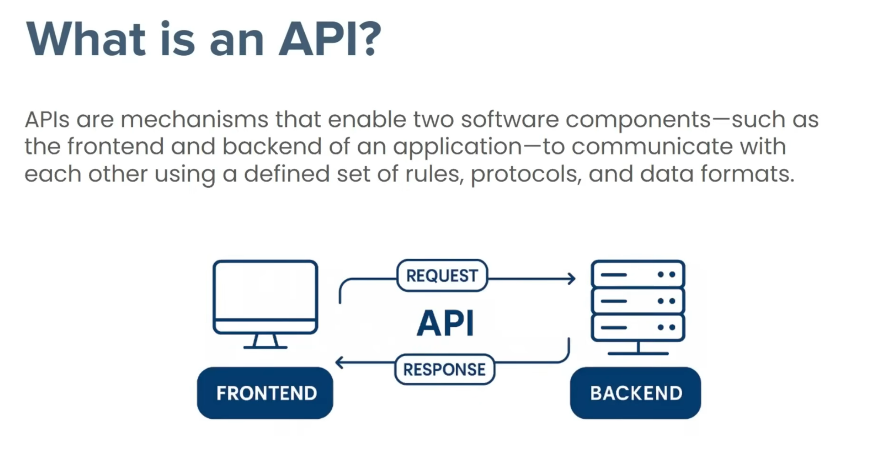

Slide 3
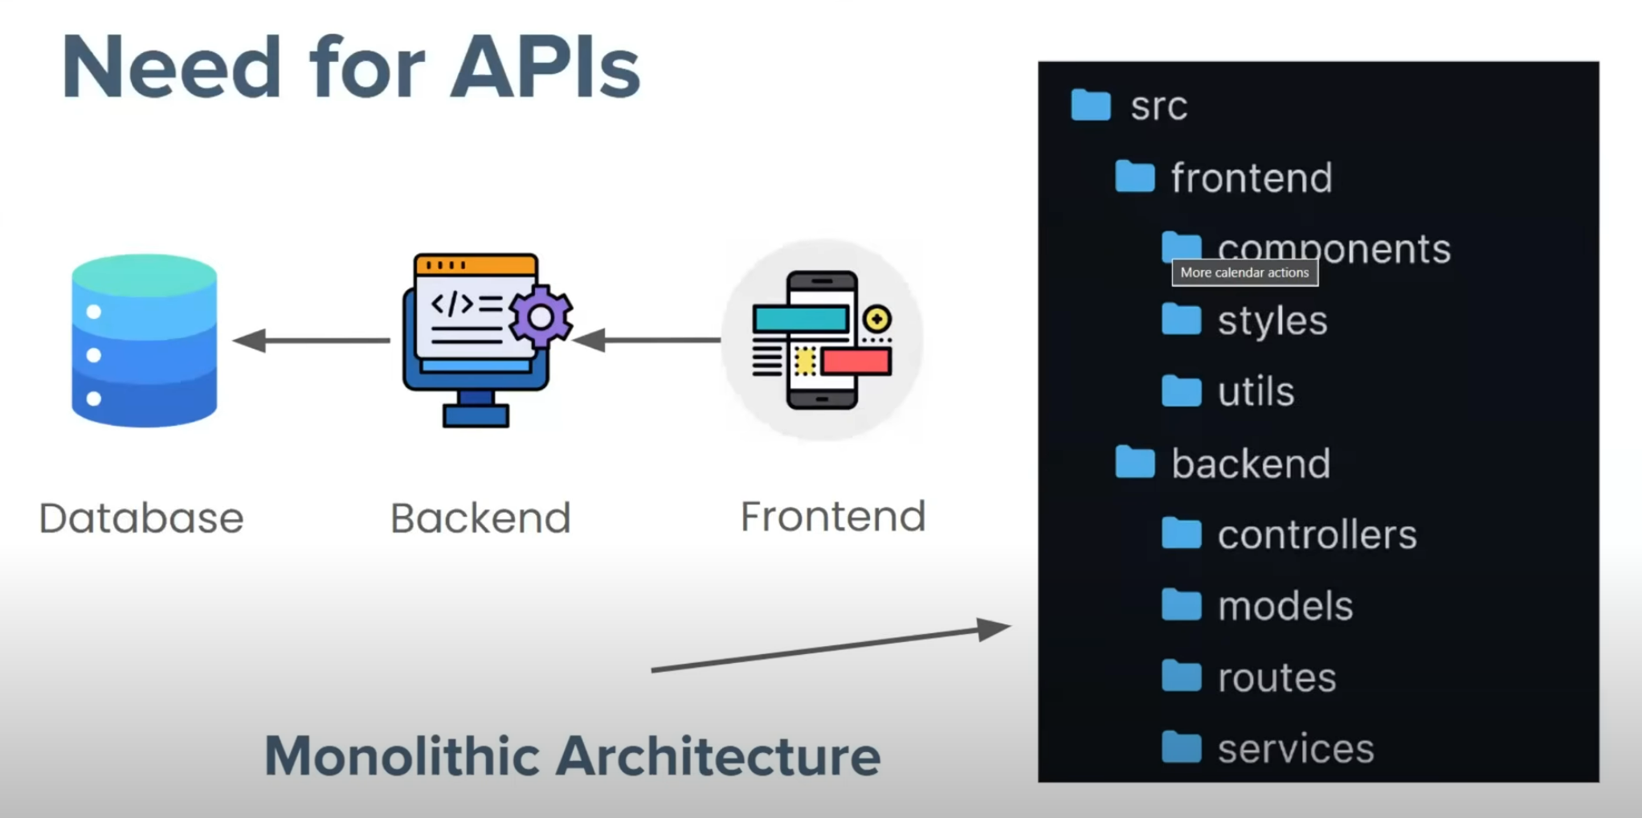
Frontend and the Backend are tightly coupled with each other and contained with in a single folder. Any small change with in any file will affect the entire application.

Slide 4
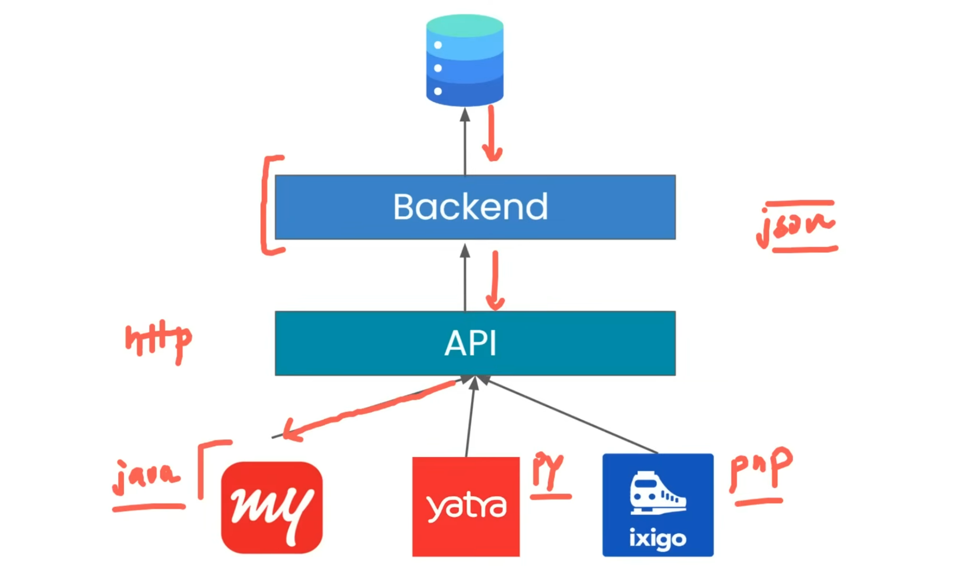

Slide 5
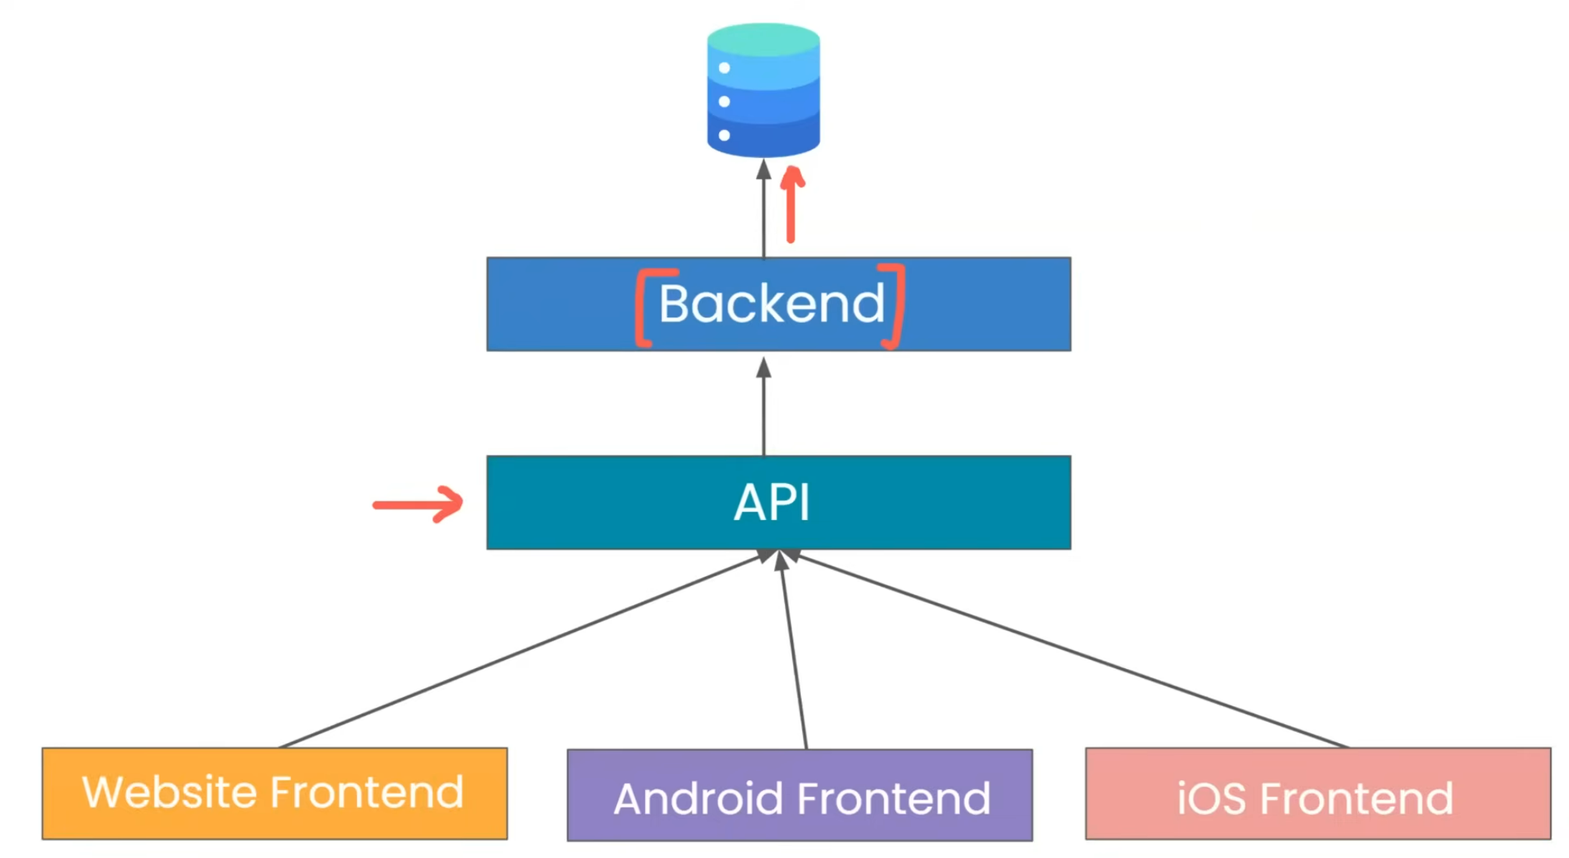

Slide 6
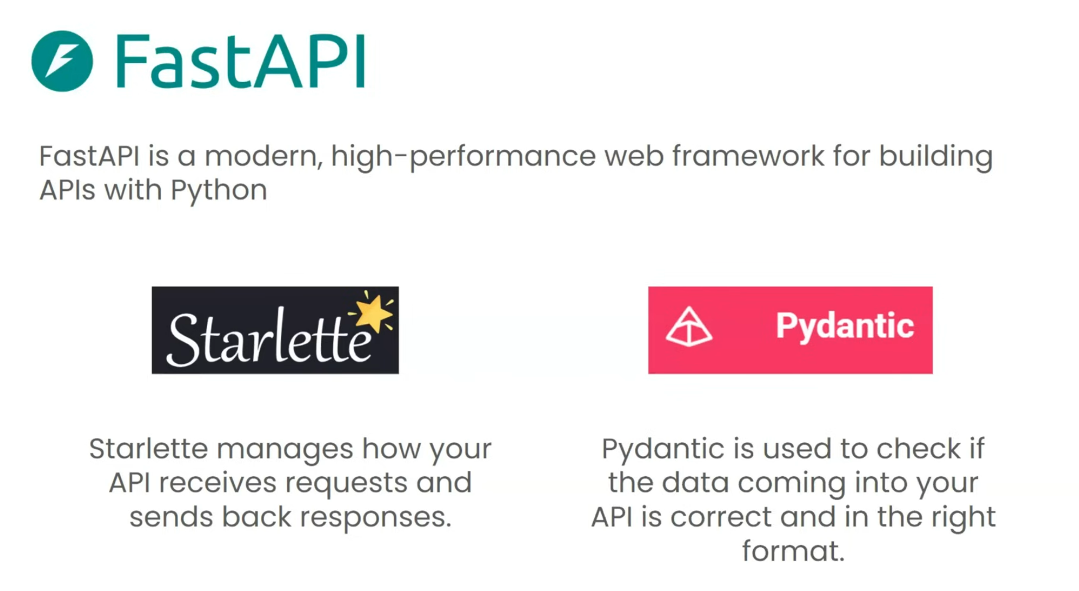

Slide 7
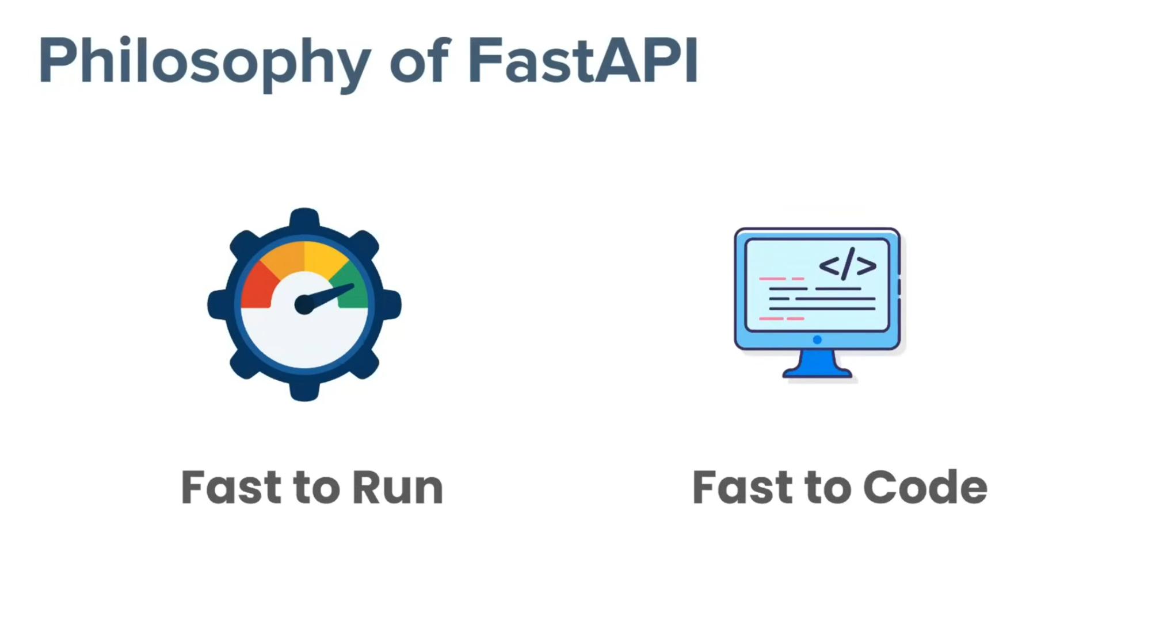

Slide 8
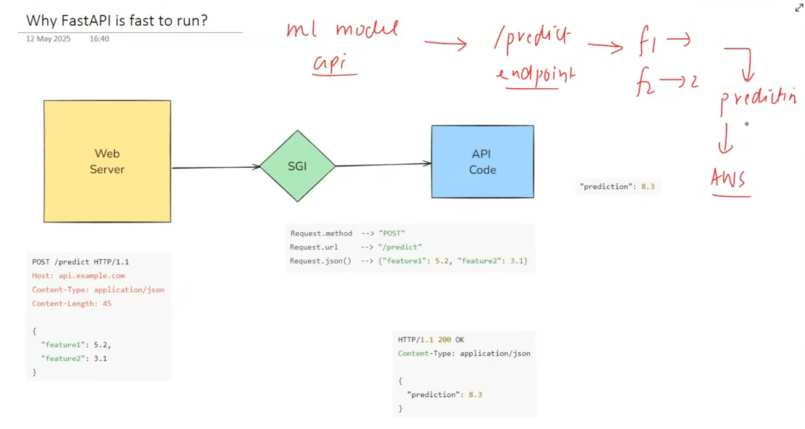

Slide 9
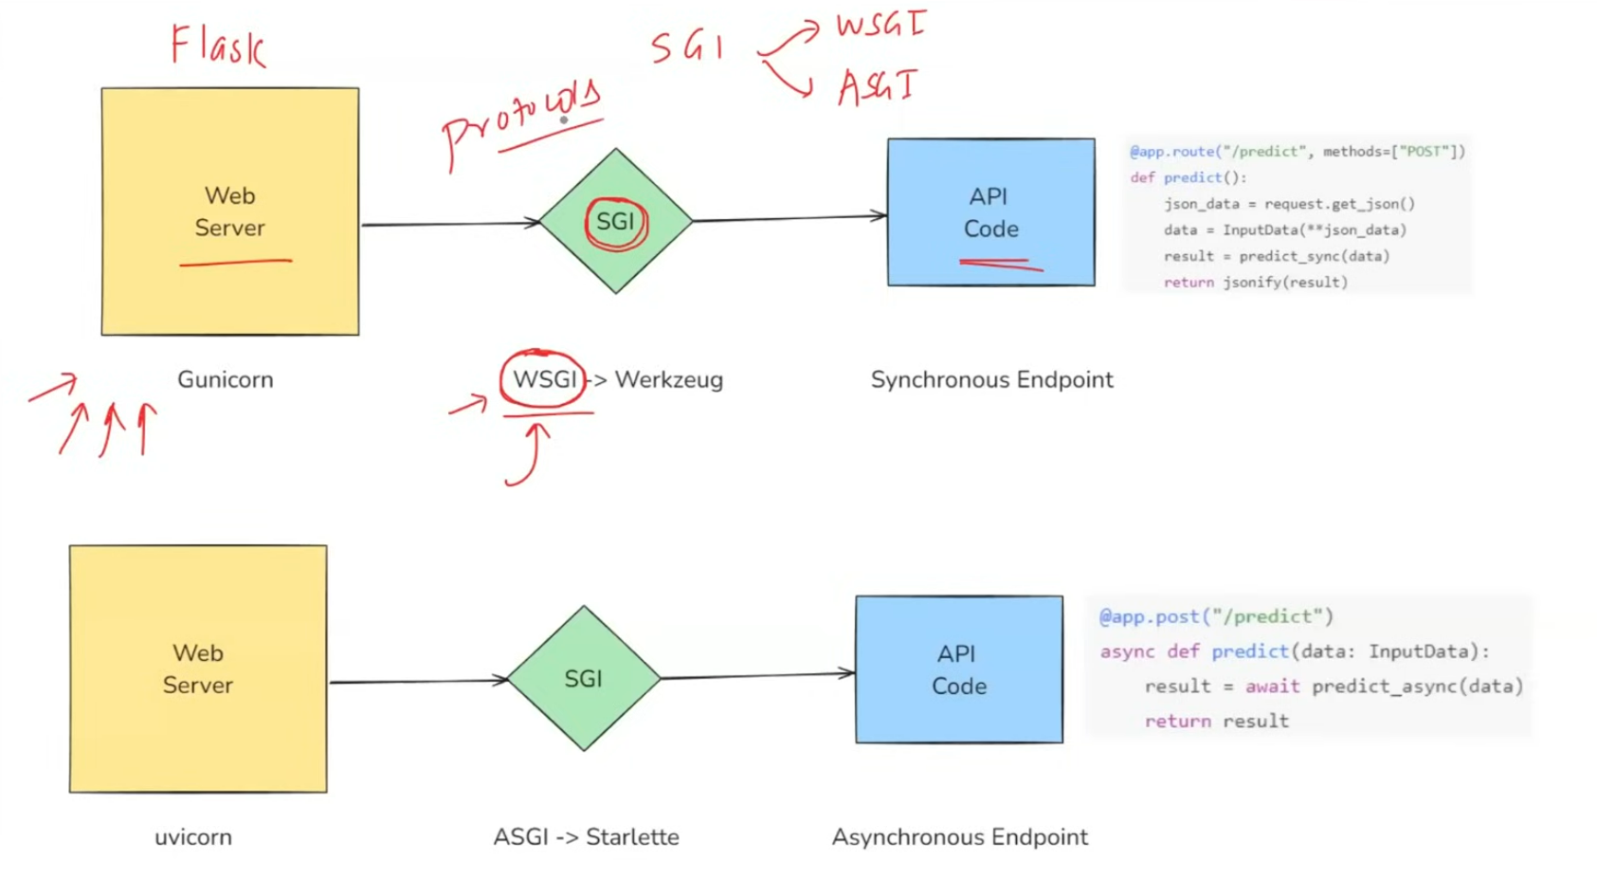

Slide 10
WSGI (Web Server Gateway Interface) and ASGI (Asynchronous Server Gateway Interface) are both specifications for Python web applications, but they cater to different needs and use cases. Here’s a comparison of the two:
Key Differences
1. Concurrency Model
WSGI:
Synchronous model.
Handles one request at a time per worker.
Suitable for traditional web applications that do not require real-time capabilities.
ASGI:
Asynchronous model.
Supports handling multiple requests concurrently using asynchronous programming (e.g., async and await).
Ideal for applications requiring real-time features, such as WebSockets or long-lived connections.
2. Use Cases
WSGI:
Best for standard web applications (e.g., Django, Flask).
Suitable for applications that do not need to handle many simultaneous connections or real-time updates.
ASGI:
Designed for modern applications that need to handle WebSockets, HTTP/2, and other asynchronous protocols.
Used in frameworks like FastAPI and Django Channels, which require real-time capabilities.

Slide 11
3. Framework Support
WSGI:
Supported by many traditional frameworks like Flask, Django (in its standard form), and Pyramid.
ASGI:
Supported by frameworks designed for asynchronous programming, such as FastAPI, Starlette, and the newer versions of Django (with Channels).
4. Performance
WSGI:
May be limited by the synchronous nature, potentially leading to performance bottlenecks under heavy load.
ASGI:
Can handle many connections simultaneously, making it more efficient for I/O-bound applications.
Summary
WSGI is suitable for traditional synchronous web applications, while ASGI is designed for modern, asynchronous applications that require concurrency and real-time features. Choosing between them depends on the specific needs of your application.

Slide 12
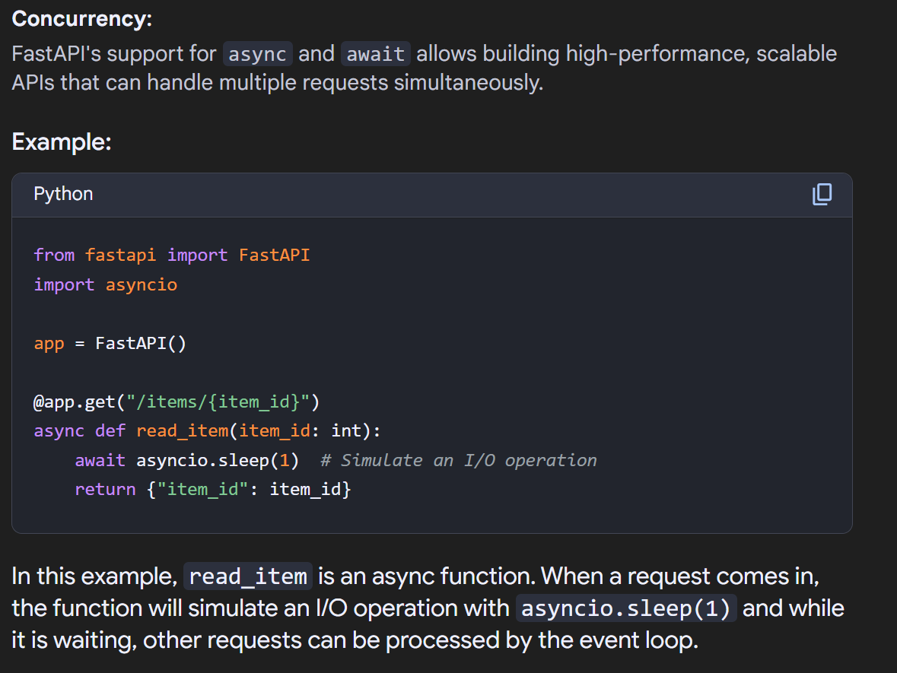
🚀 Asynchronous Programming in FastAPI –
FastAPI allows the use of `async` and `await` to define asynchronous path operations, enabling non-blocking I/O operations that can significantly improve performance, especially in high-concurrency applications.
📚 Using `async def` -
By using `async def` for endpoint functions, FastAPI can effectively manage requests that involve waiting for external resources, making it crucial for building efficient APIs
🛠️ Best Practices
It is recommended to use `async` in all non-trivial endpoint definitions and `await` for I/O-bound tasks like HTTP requests to prevent blocking the event loop, ensuring responsive applications.

Slide 13
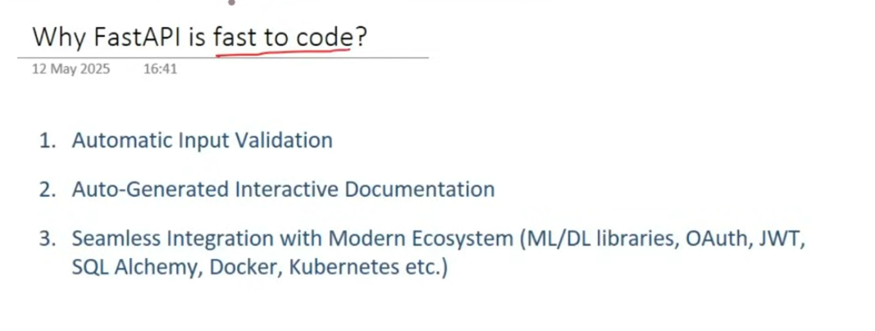
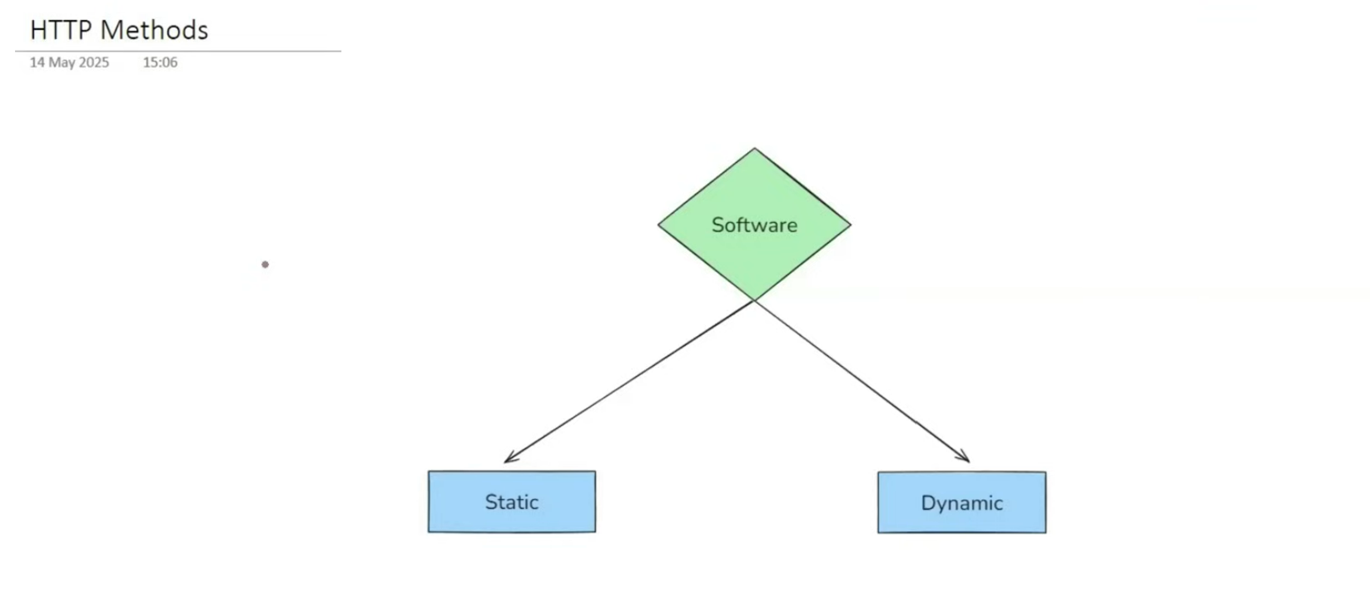

Slide 14
CRUD
CREATE
RETRIEVE
UPDATE
DELETE
Static
Blog
Govt. Websites
Client
HTTP
Server
Dynamic
Instagram
Facebook (interactive, posting comments, hitting likes)
Website

Slide 15
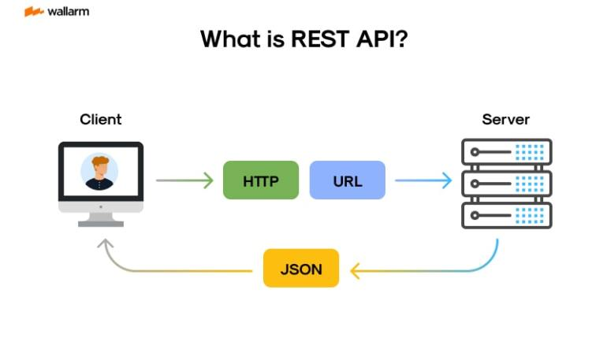
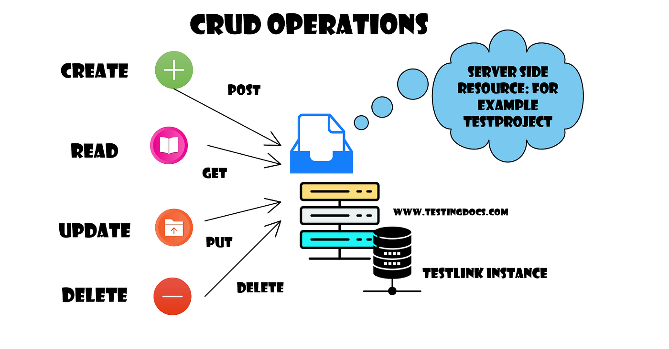

Slide 16
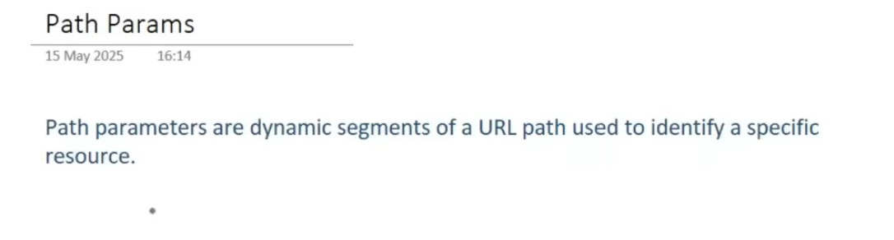
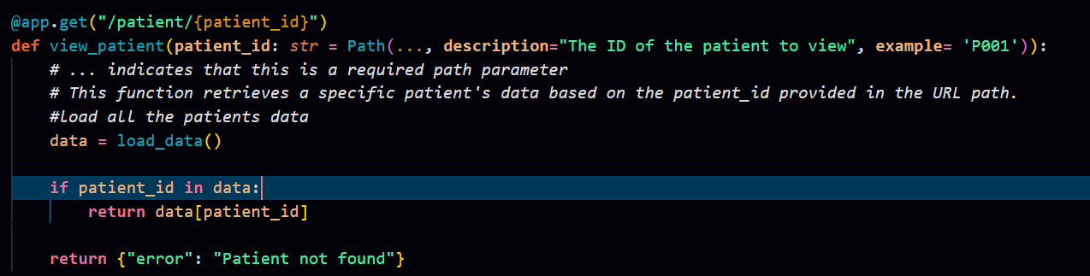
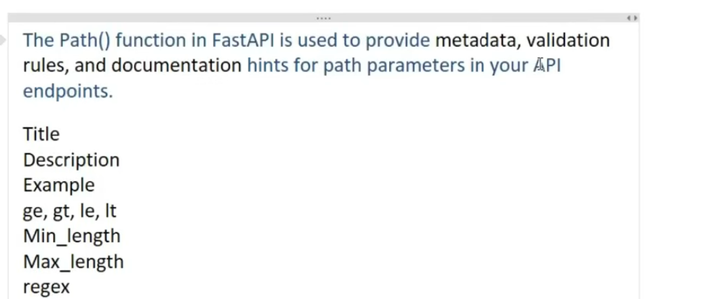




Slide 17
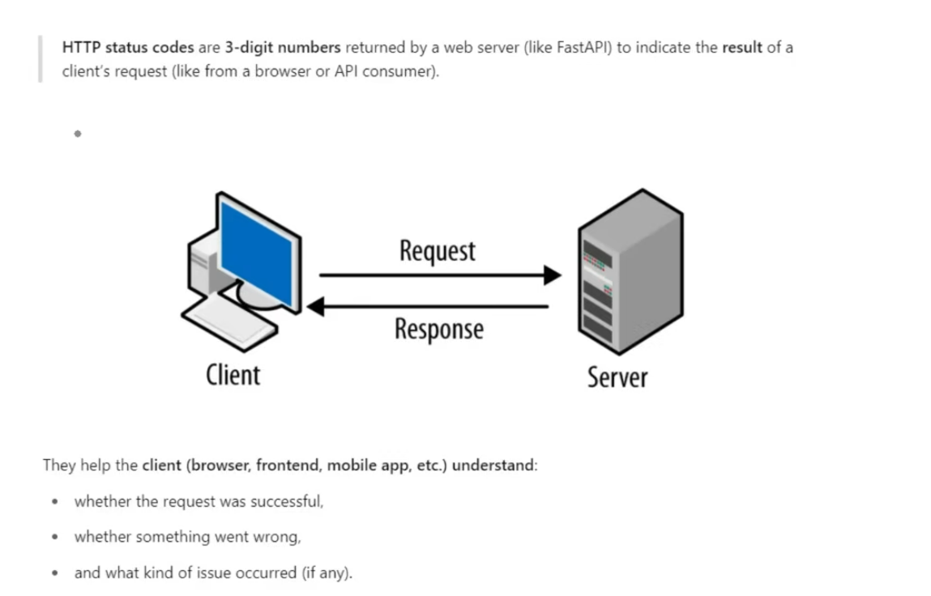
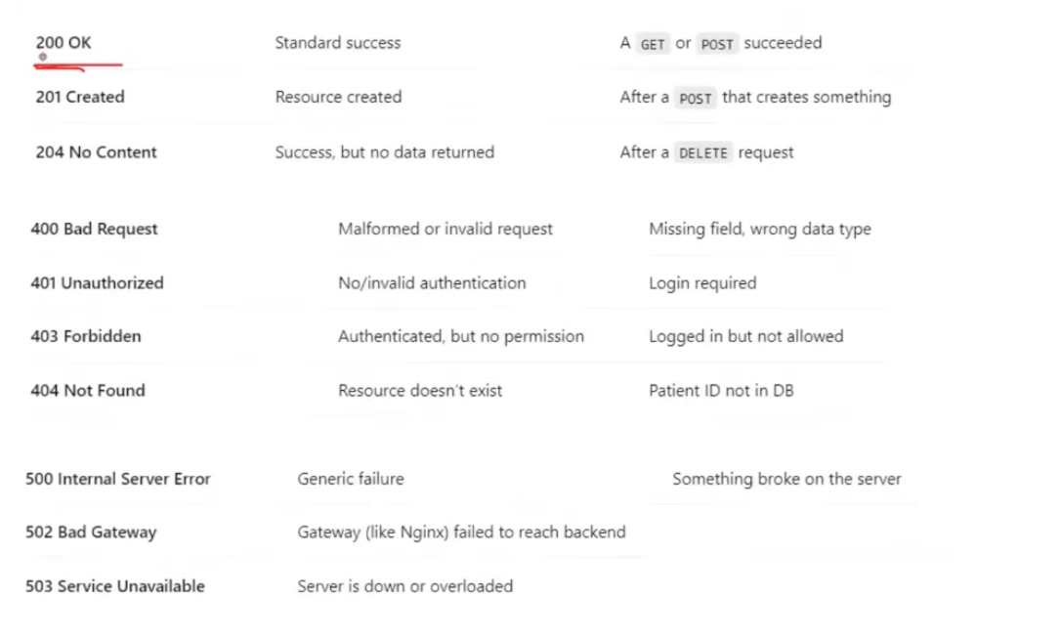
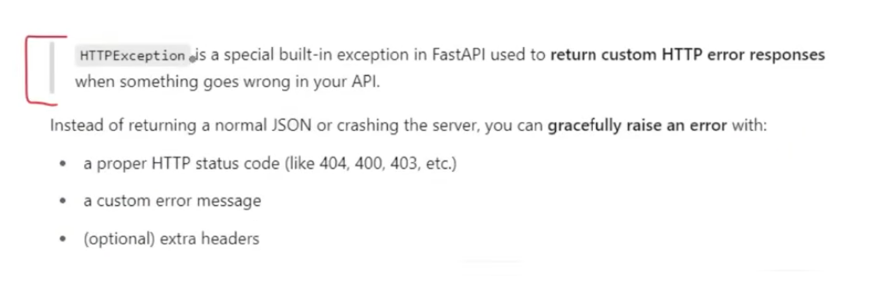
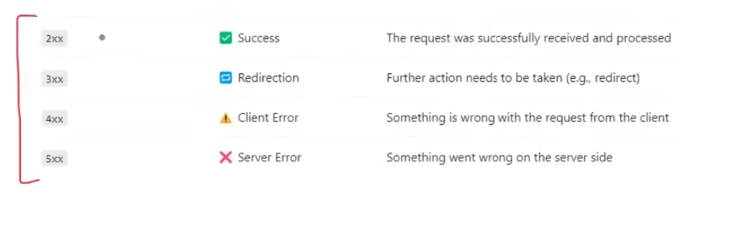

Slide 18
